Slide 1
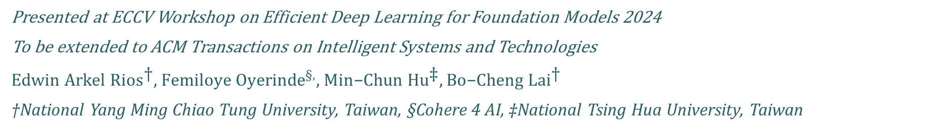
Down-Sampling Inter-Layer Adapter with Mid-Training Discrimination for Parameter Efficient Ultra Fine-Grained Image Recognition
Presented at ECCV Workshop on Efficient Deep Learning for Foundation Models 2024
To be extended to ACM Transactions on Intelligent Systems and Technologies
${Edwin Arkel Rios}^{\text{†}}$, $Femiloye {Oyerinde}^{§,}$, ${\text{Min}\text{−}\text{Chun} \text{Hu}}^{\text{‡}},\text{Bo}\text{−}\text{Cheng} {Lai}^{\text{†}}$
†National Yang Ming Chiao Tung University, Taiwan, §Cohere 4 AI, ‡National Tsing Hua University, Taiwan
Notes:
https://dl.acm.org/journal/tist/cfp
https://dl.acm.org/pb-assets/static_journal_pages/tist/pdf/ACM-TIST-CFP-SI-Transformers-1733429756037.pdf
https://dl.acm.org/journal/tist/author-guidelines

Slide 2
Index
Paper Sections
Introduction
Related Work
Proposed Method
Experiment Methodology
Results and Discussion
Conclusion

Slide 3
Paper Sections

Slide 4
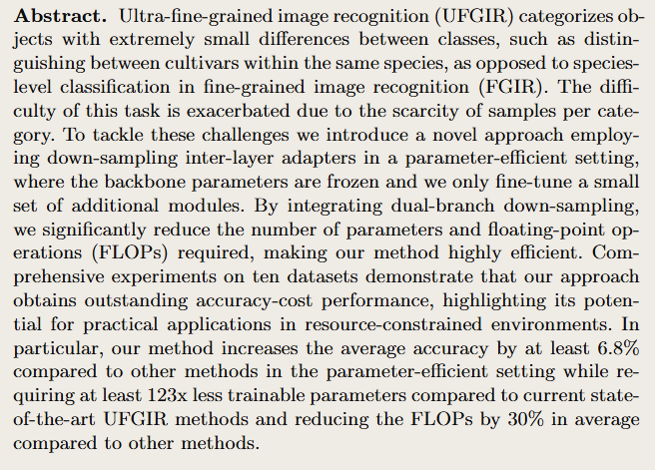
Abstract
UFGIR introduction: definition and challenges
UFGIR methods and issues
Proposed method
Experiment results
Notes:
Ultra-fine-grained image recognition (UFGIR) categorizes objects with extremely small differences between classes, such as distinguishing between cultivars within the same species, as opposed to species-level classification in fine-grained image recognition (FGIR). The difficulty of this task is exacerbated due to the scarcity of samples per category. To tackle these challenges we introduce a novel approach employing down-sampling inter-layer adapters in a parameter-efficient setting, where the backbone parameters are frozen and we only fine-tune a small set of additional modules. By integrating dual-branch down-sampling, we significantly reduce the number of parameters and floating-point operations (FLOPs) required, making our method highly efficient. Comprehensive experiments on ten datasets demonstrate that our approach obtains outstanding accuracy-cost performance, highlighting its potential for practical applications in resource-constrained environments. In particular, our method increases the average accuracy by at least 6.8\% compared to other methods in the parameter-efficient setting while requiring at least 123x less trainable parameters compared to current state-of-the-art UFGIR methods and reducing the FLOPs by 30\% in average compared to other methods.

Slide 5
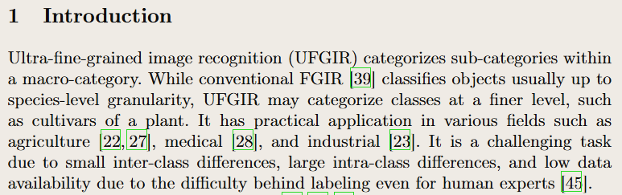
Introduction
UFGIR definition, applications and challenges
Notes:
\section{Introduction}\label{sec_intro}Ultra-fine-grained image recognition (UFGIR) categorizes sub-categories within a macro-category. While conventional FGIR \cite{wei_fine-grained_2021} classifies objects usually up to species-level granularity, UFGIR may categorize classes at a finer level, such as cultivars of a plant. It has practical application in various fields such as agriculture \cite{larese_multiscale_2014, mohanty_using_2016}, medical \cite{park_fine-grained_2023}, and industrial \cite{lehr_automated_2020}. It is a challenging task due to small inter-class differences, large intra-class differences, and low data availability due to the difficulty behind labeling even for human experts \cite{yu_benchmark_2021}.

Slide 6
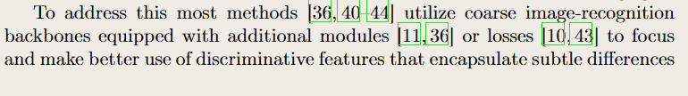
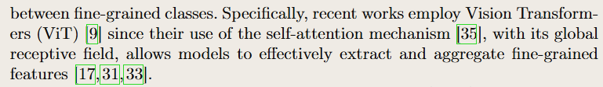
Introduction
UFGIR methods: backbones (ViT-based) + modules and losses
Notes:
To address this most methods \cite{yu_patchy_2020,yu_maskcov_2021,wang_feature_2021,yu_spare_2022,yu_cle-vit_2023,yu_mix-vit_2023} utilize coarse image-recognition backbones equipped with additional modules \cite{he_transfg_2022,wang_feature_2021} or losses \cite{yu_maskcov_2021,fang_learning_2024} to focus and make better use of discriminative features that encapsulate subtle differences between fine-grained classes. Specifically, recent works employ Vision Transformers (ViT) \cite{dosovitskiy_image_2020} since their use of the self-attention mechanism \cite{vaswani_attention_2017}, with its global receptive field, allows models to effectively extract and aggregate fine-grained features \cite{hu_rams-trans_2021,sun_sim-trans_2022,rios_anime_2022}.

Slide 7
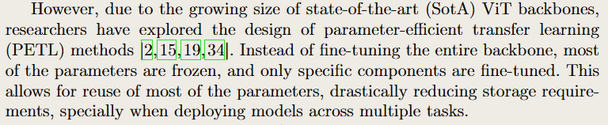
Introduction
Methods issues: growing-cost (parameters) of backbones
Notes:
However, due to the growing size of state-of-the-art (SotA) ViT backbones, researchers have explored the design of parameter-efficient transfer learning (PETL) methods \cite{houlsby_parameter-efficient_2019,avidan_improving_2022,jie_convolutional_2022,tu_visual_2023}. Instead of fine-tuning the entire backbone, most of the parameters are frozen, and only specific components are fine-tuned. This allows for reuse of most of the parameters, drastically reducing storage requirements, specially when deploying models across multiple tasks.

Slide 8
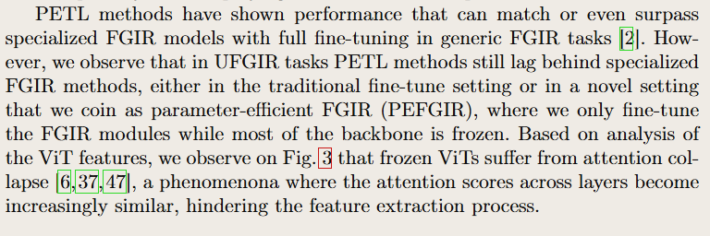
Introduction
PETL to reduce parameter-cost but has issues: attention collapse
Notes:
PETL methods have shown performance that can match or even surpass specialized FGIR models with full fine-tuning in generic FGIR tasks \cite{avidan_improving_2022}. However, we observe that in UFGIR tasks PETL methods still lag behind specialized FGIR methods, either in the traditional fine-tune setting or in a novel setting that we coin as parameter-efficient FGIR (PEFGIR), where we only fine-tune the FGIR modules while most of the backbone is frozen. Based on analysis of the ViT features, we observe on \cref{figure_cka_attention} that frozen ViTs suffer from attention collapse \cite{zhou_deepvit_2021,wang_anti-oversmoothing_2022,chen_principle_2022}, a phenomenona where the attention scores across layers become increasingly similar, hindering the feature extraction process.

Slide 9
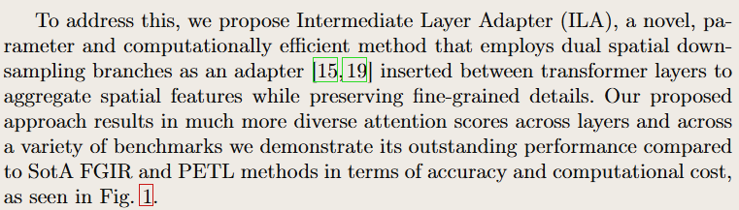
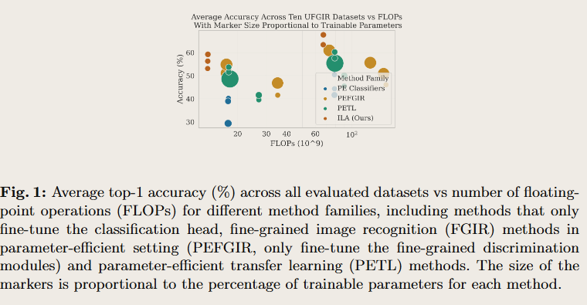
Introduction
Proposed method to address issues: PETL and collapse
Notes:
\begin{figure}[!htb] %\vspace{-0.5cm} \begin{center} \includegraphics[width=0.4\linewidth]{figures/acc_vs_flops_vs_params_log_big.png} \end{center} %\vspace{-0.5cm} \caption{Average top-1 accuracy (\%) across all evaluated datasets vs number of floating-point operations (FLOPs) for different method families, including methods that only fine-tune the classification head, fine-grained image recognition (FGIR) methods in parameter-efficient setting (PEFGIR, only fine-tune the fine-grained discrimination modules) and parameter-efficient transfer learning (PETL) methods. The size of the markers is proportional to the percentage of trainable parameters for each method.} %\vspace{-0.5cm} \label{figure_accuracy_vs_flops_vs_params}\end{figure}
To address this, we propose Intermediate Layer Adapter (ILA), a novel, parameter and computationally efficient method that employs dual spatial down-sampling branches as an adapter \cite{houlsby_parameter-efficient_2019,jie_convolutional_2022} inserted between transformer layers to aggregate spatial features while preserving fine-grained details. Our proposed approach results in much more diverse attention scores across layers and across a variety of benchmarks we demonstrate its outstanding performance compared to SotA FGIR and PETL methods in terms of accuracy and computational cost, as seen in \cref{figure_accuracy_vs_flops_vs_params}.

Slide 10
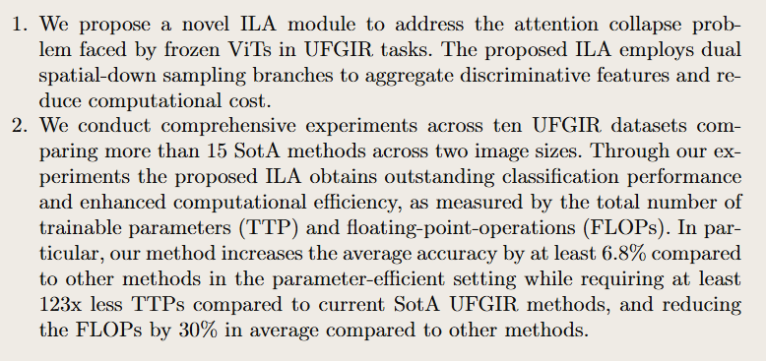
Introduction
Contributions
Notes:
Our contributions are as follows:\begin{enumerate} %\vspace{-0.25cm} \item We propose a novel ILA module to address the attention collapse problem faced by frozen ViTs in UFGIR tasks. The proposed ILA employs dual spatial-down sampling branches to aggregate discriminative features and reduce computational cost. \item We conduct comprehensive experiments across ten UFGIR datasets comparing more than 15 SotA methods across two image sizes. Through our experiments the proposed ILA obtains outstanding classification performance and enhanced computational efficiency, as measured by the total number of trainable parameters (TTP) and floating-point-operations (FLOPs). In particular, our method increases the average accuracy by at least 6.8\% compared to other methods in the parameter-efficient setting while requiring at least 123x less TTPs compared to current SotA UFGIR methods, and reducing the FLOPs by 30\% in average compared to other methods.\end{enumerate}

Slide 11
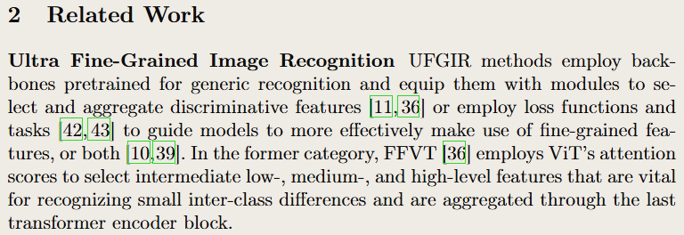
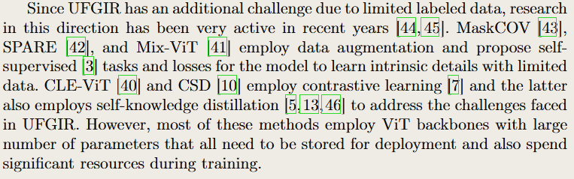
Related Work
UFGIR method description and issues
Notes:
\section{Related Work}\label{sec_related}\subsubsection{Ultra Fine-Grained Image Recognition}\label{sssec_ufgir}UFGIR methods employ backbones pretrained for generic recognition and equip them with modules to select and aggregate discriminative features \cite{he_transfg_2022,wang_feature_2021} or employ loss functions and tasks \cite{yu_maskcov_2021,yu_spare_2022} to guide models to more effectively make use of fine-grained features, or both \cite{wei_fine-grained_2021,fang_learning_2024}. In the former category, FFVT \cite{wang_feature_2021} employs ViT's attention scores to select intermediate low-, medium-, and high-level features that are vital for recognizing small inter-class differences and are aggregated through the last transformer encoder block.
Since UFGIR has an additional challenge due to limited labeled data, research in this direction has been very active in recent years \cite{yu_patchy_2020,yu_benchmark_2021}. MaskCOV \cite{yu_maskcov_2021}, SPARE \cite{yu_spare_2022}, and Mix-ViT \cite{yu_mix-vit_2023} employ data augmentation and propose self-supervised \cite{balestriero_cookbook_2023} tasks and losses for the model to learn intrinsic details with limited data. CLE-ViT \cite{yu_cle-vit_2023} and CSD \cite{fang_learning_2024} employ contrastive learning \cite{chen_simple_2020} and the latter also employs self-knowledge distillation \cite{hinton_distilling_2015,zhang_self-distillation_2022,caron_emerging_2021} to address the challenges faced in UFGIR. However, most of these methods employ ViT backbones with large number of parameters that all need to be stored for deployment and also spend significant resources during training.

Slide 12
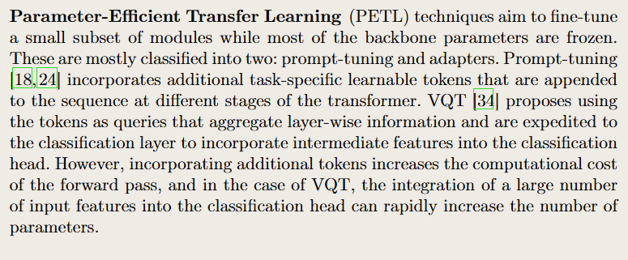
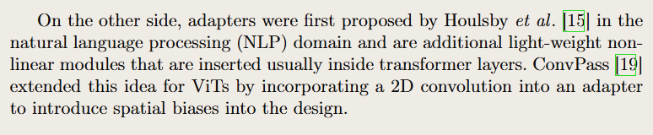
Related Work
PETL methods description and issues
Notes:
\subsubsection{Parameter-Efficient Transfer Learning}\label{sssec_petl}(PETL) techniques aim to fine-tune a small subset of modules while most of the backbone parameters are frozen. These are mostly classified into two: prompt-tuning and adapters. Prompt-tuning \cite{lester_power_2021,avidan_visual_2022} incorporates additional task-specific learnable tokens that are appended to the sequence at different stages of the transformer. VQT \cite{tu_visual_2023} proposes using the tokens as queries that aggregate layer-wise information and are expedited to the classification layer to incorporate intermediate features into the classification head. However, incorporating additional tokens increases the computational cost of the forward pass, and in the case of VQT, the integration of a large number of input features into the classification head can rapidly increase the number of parameters.On the other side, adapters were first proposed by Houlsby \etal \cite{houlsby_parameter-efficient_2019} in the natural language processing (NLP) domain and are additional light-weight non-linear modules that are inserted usually inside transformer layers. ConvPass \cite{jie_convolutional_2022} extended this idea for ViTs by incorporating a 2D convolution into an adapter to introduce spatial biases into the design.

Slide 13
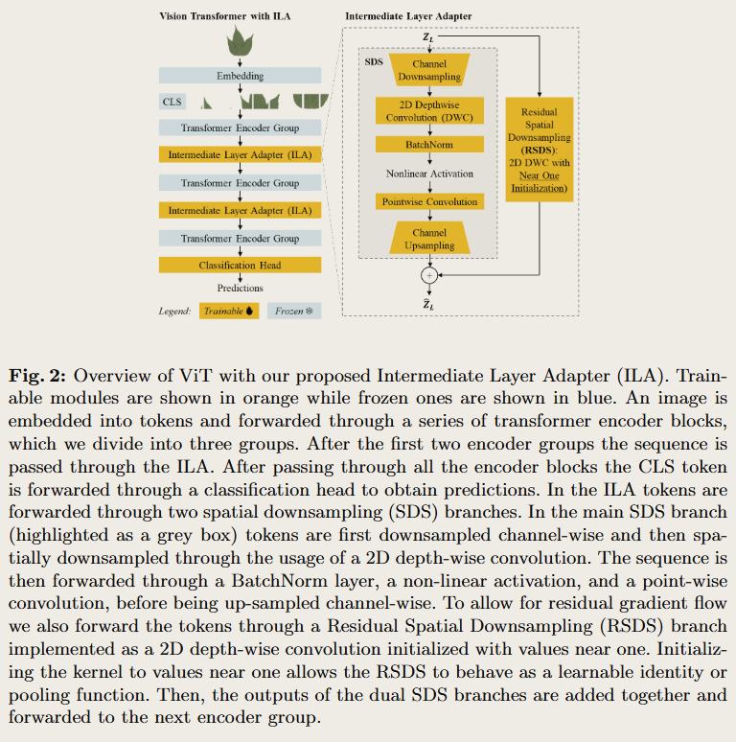
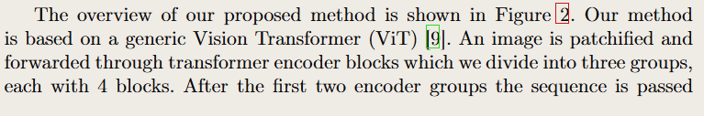
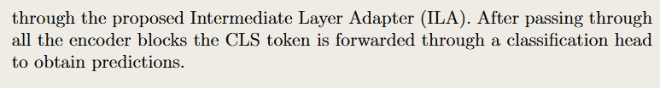
Method
Overview and figure
Notes:
\section{Method}\label{sec_method}\begin{figure}[!htb] %\vspace{-0.5cm} \begin{center} \includegraphics[width=0.6\linewidth]{figures/overview_dpi.png} \end{center} %\vspace{-0.5cm} \caption{Overview of ViT with our proposed Intermediate Layer Adapter (ILA). Trainable modules are shown in orange while frozen ones are shown in blue. An image is embedded into tokens and forwarded through a series of transformer encoder blocks, which we divide into three groups. After the first two encoder groups the sequence is passed through the ILA. After passing through all the encoder blocks the CLS token is forwarded through a classification head to obtain predictions. In the ILA tokens are forwarded through two spatial downsampling (SDS) branches. In the main SDS branch (highlighted as a grey box) tokens are first downsampled channel-wise and then spatially downsampled through the usage of a 2D depth-wise convolution. The sequence is then forwarded through a BatchNorm layer, a non-linear activation, and a point-wise convolution, before being up-sampled channel-wise. To allow for residual gradient flow we also forward the tokens through a Residual Spatial Downsampling (RSDS) branch implemented as a 2D depth-wise convolution initialized with values near one. Initializing the kernel to values near one allows the RSDS to behave as a learnable identity or pooling function. Then, the outputs of the dual SDS branches are added together and forwarded to the next encoder group.} %\vspace{-0.5cm} \label{figure_overview}\end{figure}The overview of our proposed method is shown in \Cref{figure_overview}. Our method is based on a generic Vision Transformer (ViT) \cite{dosovitskiy_image_2020}. An image is patchified and forwarded through transformer encoder blocks which we divide into three groups, each with 4 blocks. After the first two encoder groups the sequence is passed through the proposed Intermediate Layer Adapter (ILA). After passing through all the encoder blocks the CLS token is forwarded through a classification head to obtain predictions.

Slide 14
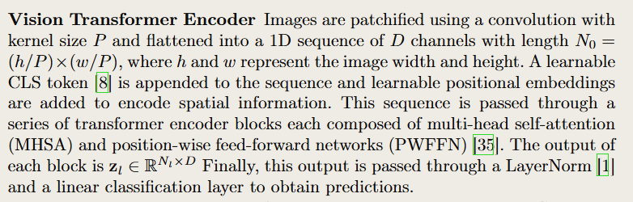
Method
Description of first component (feature extractor / encoder / backbone)
Notes:
\subsubsection{Vision Transformer Encoder}\label{sssec_vit}Images are patchified using a convolution with kernel size $P$ and flattened into a 1D sequence of $D$ channels with length $N_0 = (h / P) \times (w / P)$, where $h$ and $w$ represent the image width and height. A learnable CLS token \cite{devlin_bert_2019} is appended to the sequence and learnable positional embeddings are added to encode spatial information. This sequence is passed through a series of transformer encoder blocks each composed of multi-head self-attention (MHSA) and position-wise feed-forward networks (PWFFN) \cite{vaswani_attention_2017}. The output of each block is $\mathbf{z}_l \in \mathbb{R}^{N_l\times D}$ Finally, this output is passed through a LayerNorm \cite{ba_layer_2016} and a linear classification layer to obtain predictions.

Slide 15
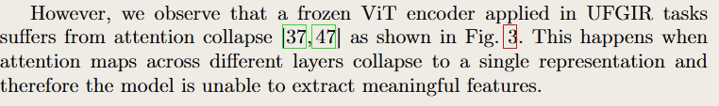
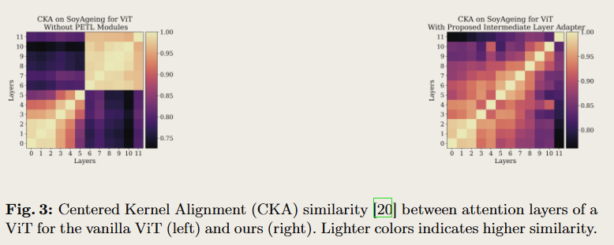
Method
Issue with encoder: collapse
Notes:
However, we observe that a frozen ViT encoder applied in UFGIR tasks suffers from attention collapse \cite{zhou_deepvit_2021,wang_anti-oversmoothing_2022} as shown in \cref{figure_cka_attention}. This happens when attention maps across different layers collapse to a single representation and therefore the model is unable to extract meaningful features.\begin{figure}[!htb] %\vspace{-0.5cm} \centering \begin{minipage}{0.29\textwidth} \centering \includegraphics[width=\textwidth]{figures/cka_attn_soyageing_vanilla.png} % \caption{Caption for figure 1} \label{figure_cka_attention_soyageing_vanilla} \end{minipage} \hfill \begin{minipage}{0.29\textwidth} \centering \includegraphics[width=\textwidth]{figures/cka_attn_soyageing_ila.png} % \caption{Caption for figure 3} \label{figure_cka_attention_soyageing_ila} \end{minipage} %\vspace{-0.5cm} \caption{Centered Kernel Alignment (CKA) similarity \cite{kornblith_similarity_2019} between attention layers of a ViT for the vanilla ViT (left) and ours (right). Lighter colors indicates higher similarity.} %\vspace{-0.5cm} \label{figure_cka_attention}\end{figure}%\vspace{-0.5cm}

Slide 16
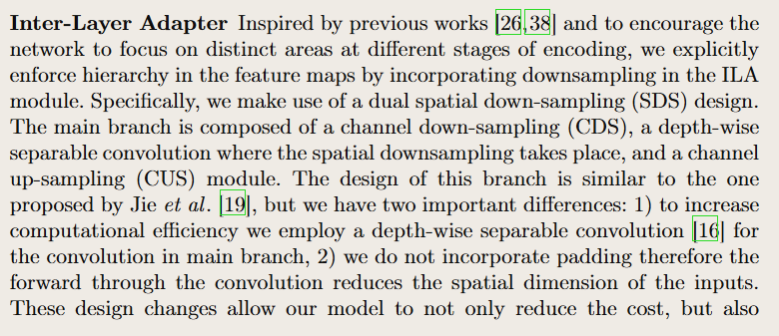
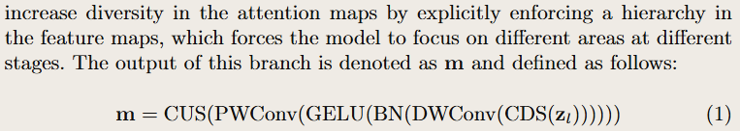
Method
Inspiration and description of our method (first component)
Notes:
\subsubsection{Inter-Layer Adapter}\label{sssec_ila}Inspired by previous works \cite{liu_swin_2021,wang_pyramid_2021} and to encourage the network to focus on distinct areas at different stages of encoding, we explicitly enforce hierarchy in the feature maps by incorporating downsampling in the ILA module. Specifically, we make use of a dual spatial down-sampling (SDS) design. The main branch is composed of a channel down-sampling (CDS), a depth-wise separable convolution where the spatial downsampling takes place, and a channel up-sampling (CUS) module. The design of this branch is similar to the one proposed by Jie \etal. \cite{jie_convolutional_2022}, but we have two important differences: 1) to increase computational efficiency we employ a depth-wise separable convolution \cite{howard_mobilenets_2017} for the convolution in main branch, 2) we do not incorporate padding therefore the forward through the convolution reduces the spatial dimension of the inputs. These design changes allow our model to not only reduce the cost, but also increase diversity in the attention maps by explicitly enforcing a hierarchy in the feature maps, which forces the model to focus on different areas at different stages. The output of this branch is denoted as $\mathbf{m}$ and defined as follows:\begin{equation} \mathbf{m} = \text{CUS}(\text{PWConv}(\text{GELU}(\text{BN}(\text{DWConv}(\text{CDS}(\mathbf{z}_l)))))) \label{eq_sds_main}\end{equation}

Slide 17
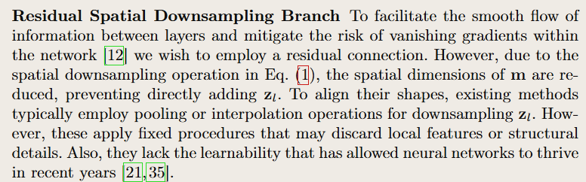
Method
Inspiration (issues with previous) of method (second component)
Notes:
To facilitate the smooth flow of information between layers and mitigate the risk of vanishing gradients within the network \cite{he_deep_2015} we wish to employ a residual connection. However, due to the spatial downsampling operation in \cref{eq_sds_main}, the spatial dimensions of $\mathbf{m}$ are reduced, preventing directly adding $\mathbf{z}_l$. To align their shapes, existing methods typically employ pooling or interpolation operations for downsampling $\mathbf{z}_l$. However, these apply fixed procedures that may discard local features or structural details. Also, they lack the learnability that has allowed neural networks to thrive in recent years \cite{krizhevsky_imagenet_2012,vaswani_attention_2017}.

Slide 18
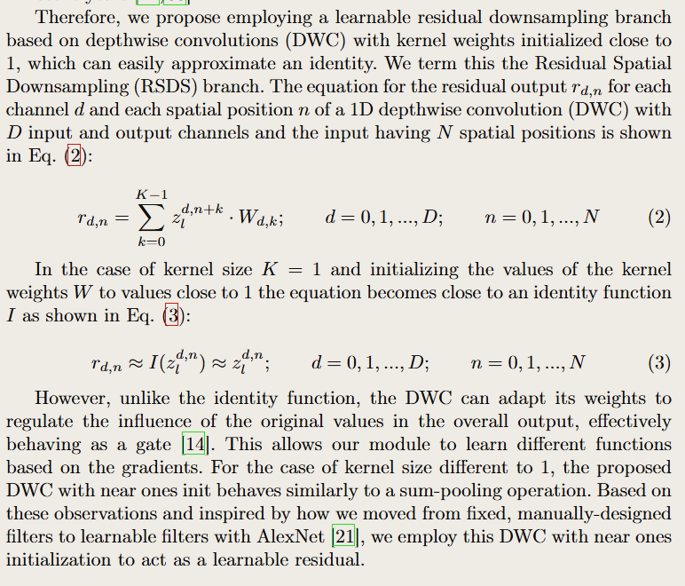
Method
How does our method address issue with inspiration
Notes:
Therefore, we propose employing a learnable residual downsampling branch based on depthwise convolutions (DWC) with kernel weights initialized close to 1, which can easily approximate an identity. We term this the Residual Spatial Downsampling (RSDS) branch. The equation for the residual output $r_{d,n}$ for each channel $d$ and each spatial position $n$ of a 1D depthwise convolution (DWC) with $D$ input and output channels and the input having $N$ spatial positions is shown in \cref{eq_dw_1d}:\begin{equation} % 1D Depthwise Convolution with Multiple Channels r_{d,n} = \sum_{k=0}^{K-1} z_l^{d,n+k} \cdot W_{d,k}; \qquad d=0,1,...,D; \qquad n=0,1,...,N \label{eq_dw_1d}\end{equation}In the case of kernel size $K=1$ and initializing the values of the kernel weights $W$ to values close to 1 the equation becomes close to an identity function $I$ as shown in \cref{eq_dw_approach_identity}:\begin{equation} % 1D Depthwise Convolution with Multiple Channels r_{d,n} \approx I(z_l^{d,n}) \approx z_l^{d,n}; \qquad d=0,1,...,D; \qquad n=0,1,...,N \label{eq_dw_approach_identity}\end{equation}However, unlike the identity function, the DWC can adapt its weights to regulate the influence of the original values in the overall output, effectively behaving as a gate \cite{hochreiter_long_1997}. This allows our module to learn different functions based on the gradients. For the case of kernel size different to 1, the proposed DWC with near ones init behaves similarly to a sum-pooling operation. Based on these observations and inspired by how we moved from fixed, manually-designed filters to learnable filters with AlexNet \cite{krizhevsky_imagenet_2012}, we employ this DWC with near ones initialization to act as a learnable residual.

Slide 19
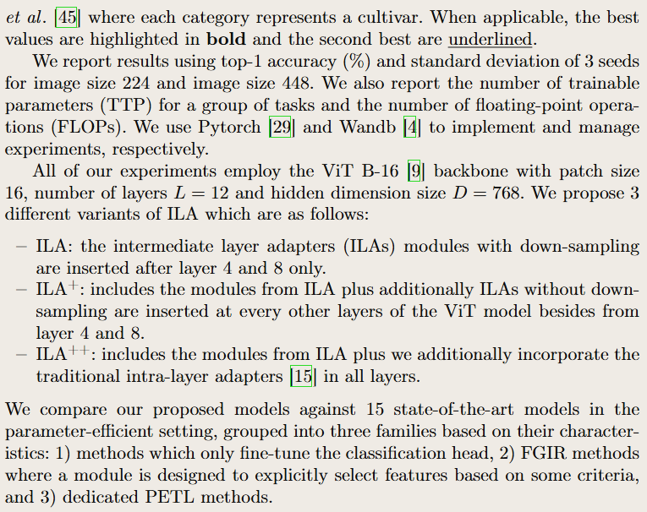
Methodology
Experiment description: datasets, metrics, hyperparameters, backbone, constants, compared methods

Slide 20
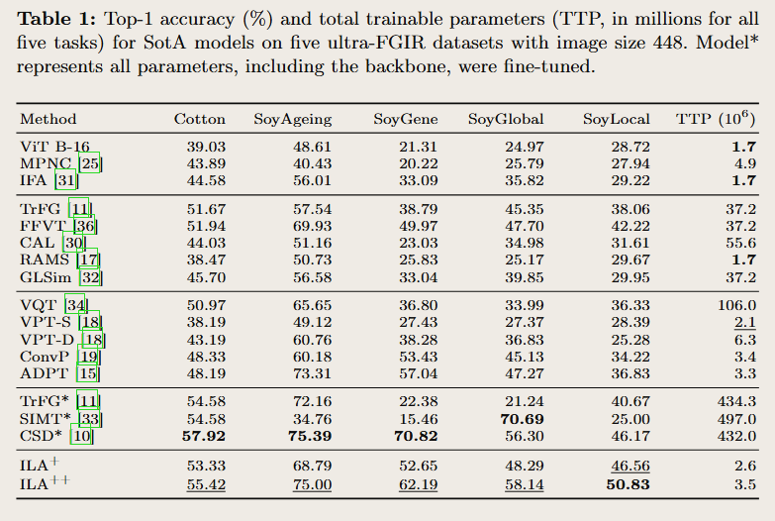
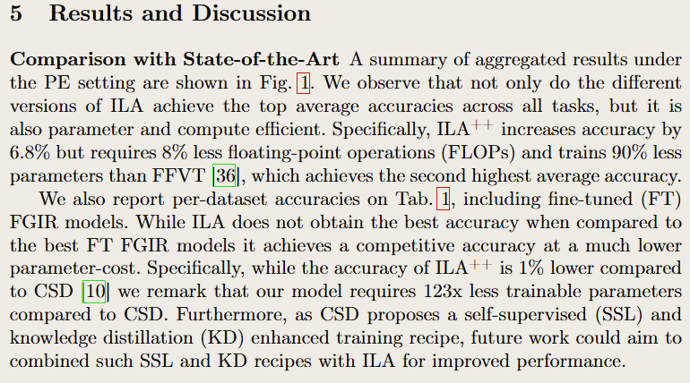
Results
Comparison with SotA

Slide 21
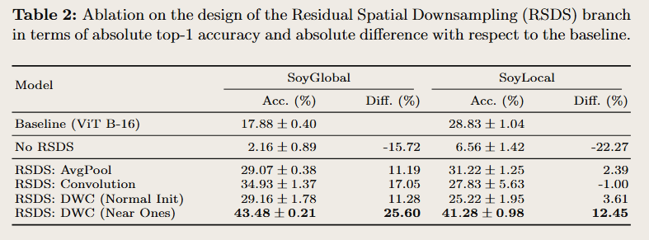
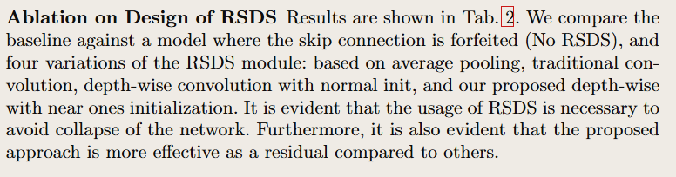
Results
Ablation on design

Slide 22
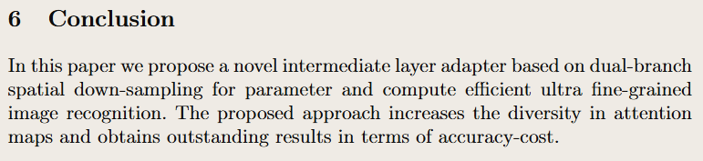
Conclusion

Slide 23
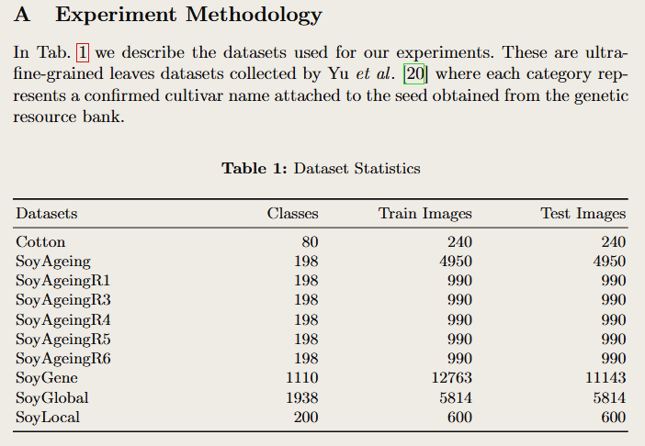
Appendix
Datasets

Slide 24
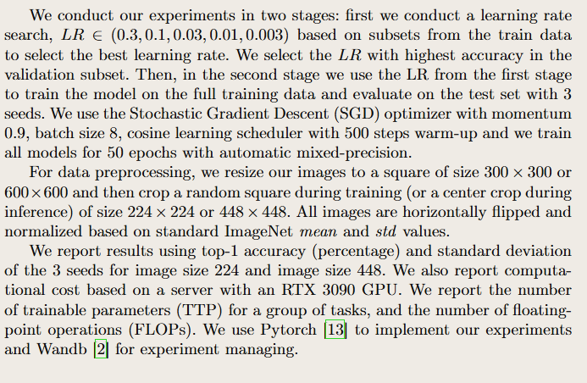
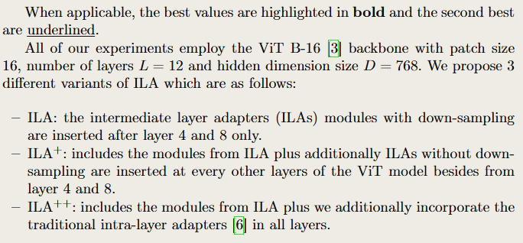
Appendix
Detailed experiment settings

Slide 25
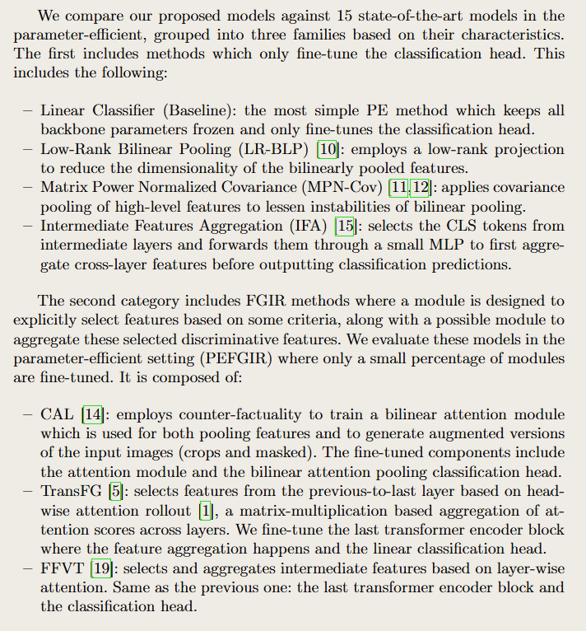
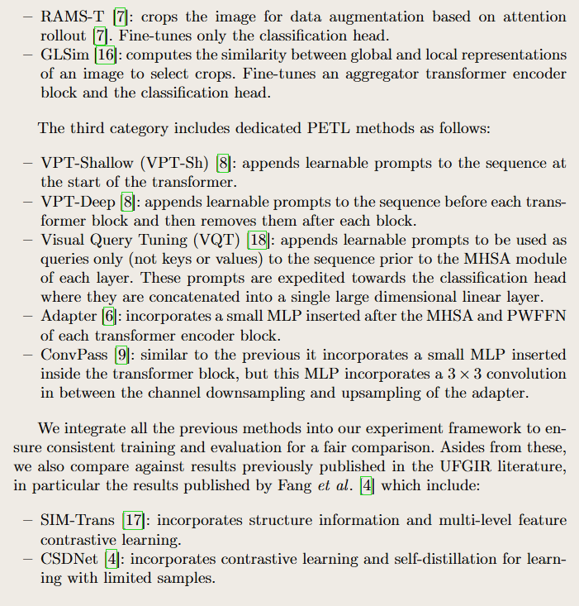
Appendix
Detailed descriptions of compared methods

Slide 26
Introduction

Slide 27
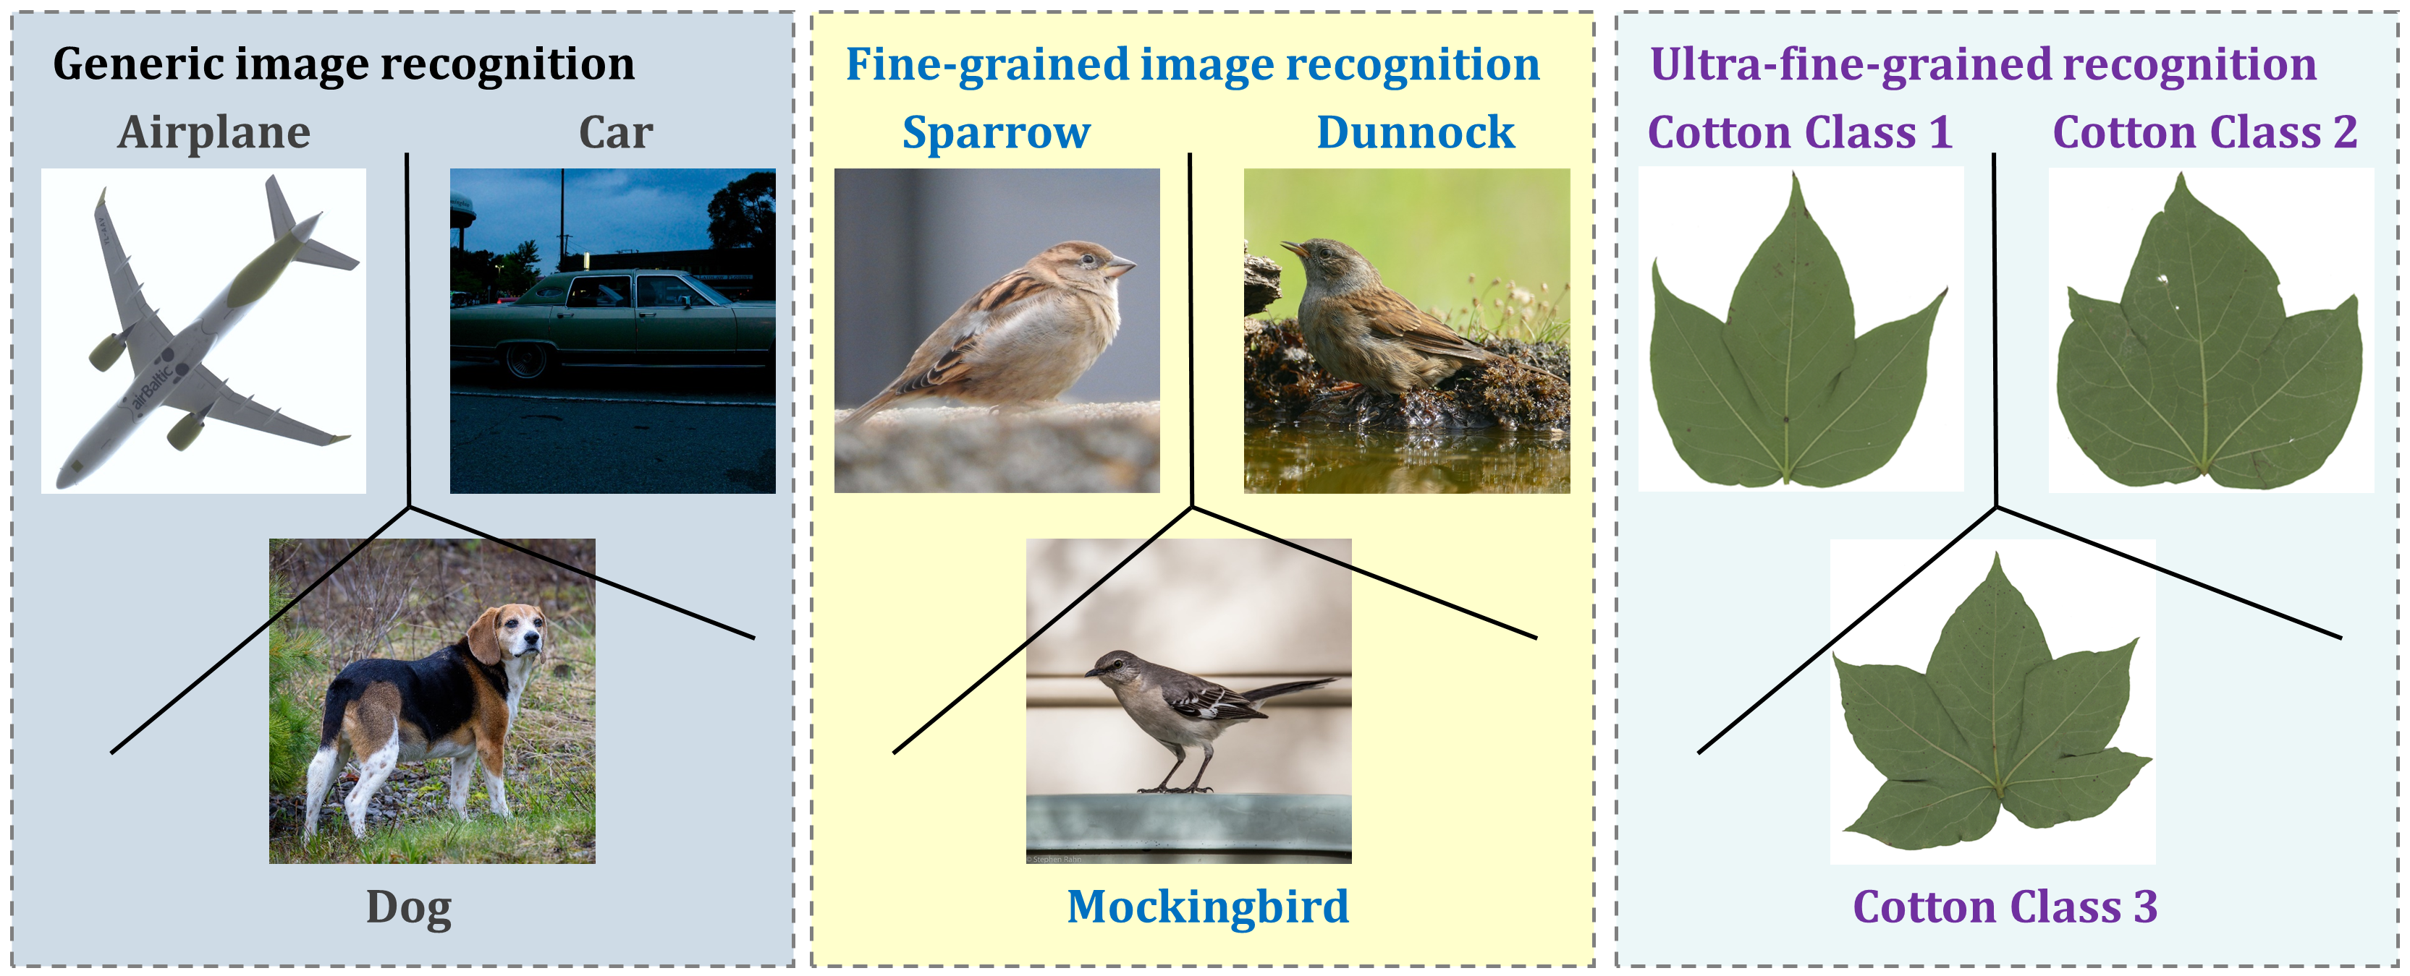
FGIR and UFGIR
Fine-grained image recognition (FGIR): classify sub-categories from a super-category (e.g., species of birds or car models)
Ultra-fine-grained image recognition (UFGIR): cultivars of a species
Notes:
Extreme granularity: instance or individual level recognition
Also known as FGIC, FGVC, FGVR

Slide 28
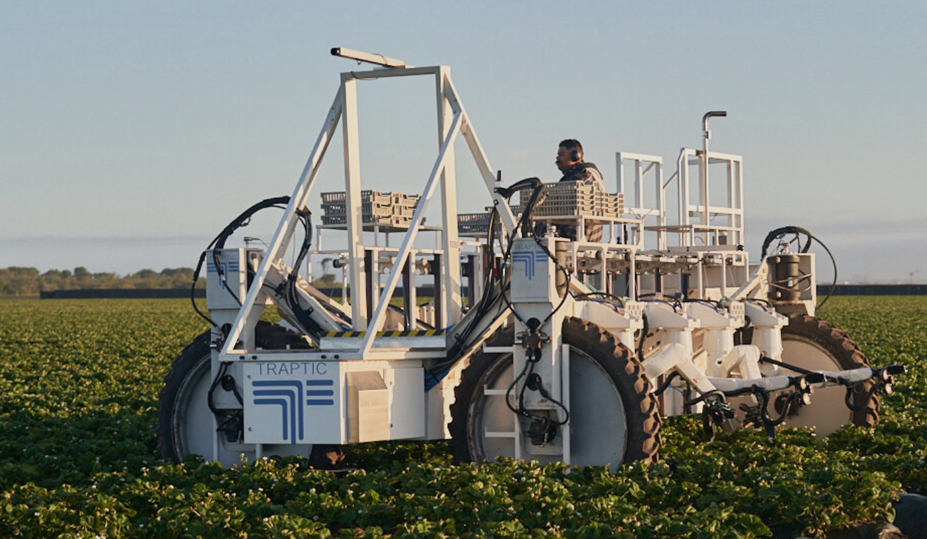
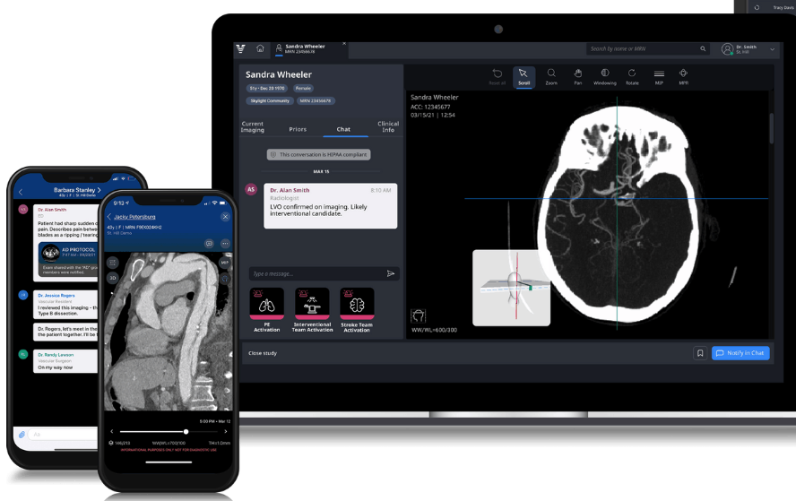
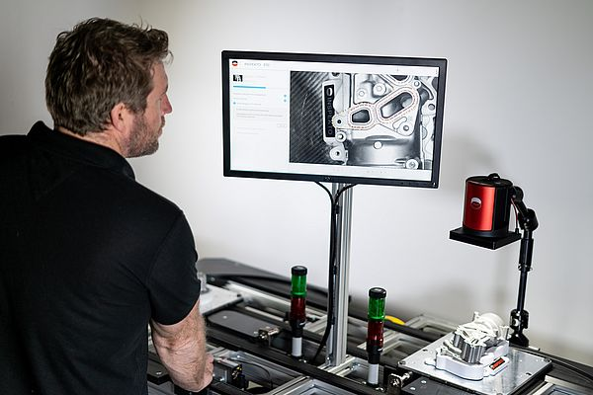
FGIR Applications
Agriculture, healthcare, industrial automation
https://www.traptic.com/
https://www.viz.ai/
https://www.ien.eu/article/bmw-chooses-inspekto-to-bring-ai-to-the-factory-floor/
Notes:
Agriculture: increase farming yield by combining vision and robotics to identify ripe crops and disease or pests
Healthcare: early detection of strokes from patient’s brain scan
Industrial automation: automated optical inspection for automotive, semiconductors, machinery and other industries

Slide 29
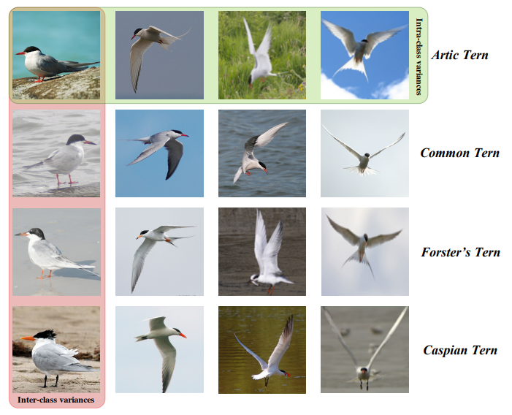
FGIR Challenges
Small inter-class and large intra-class variations
Deep Learning for Fine-Grained Image Analysis: A Survey. Wei et al. TPAMI 2022

Slide 30
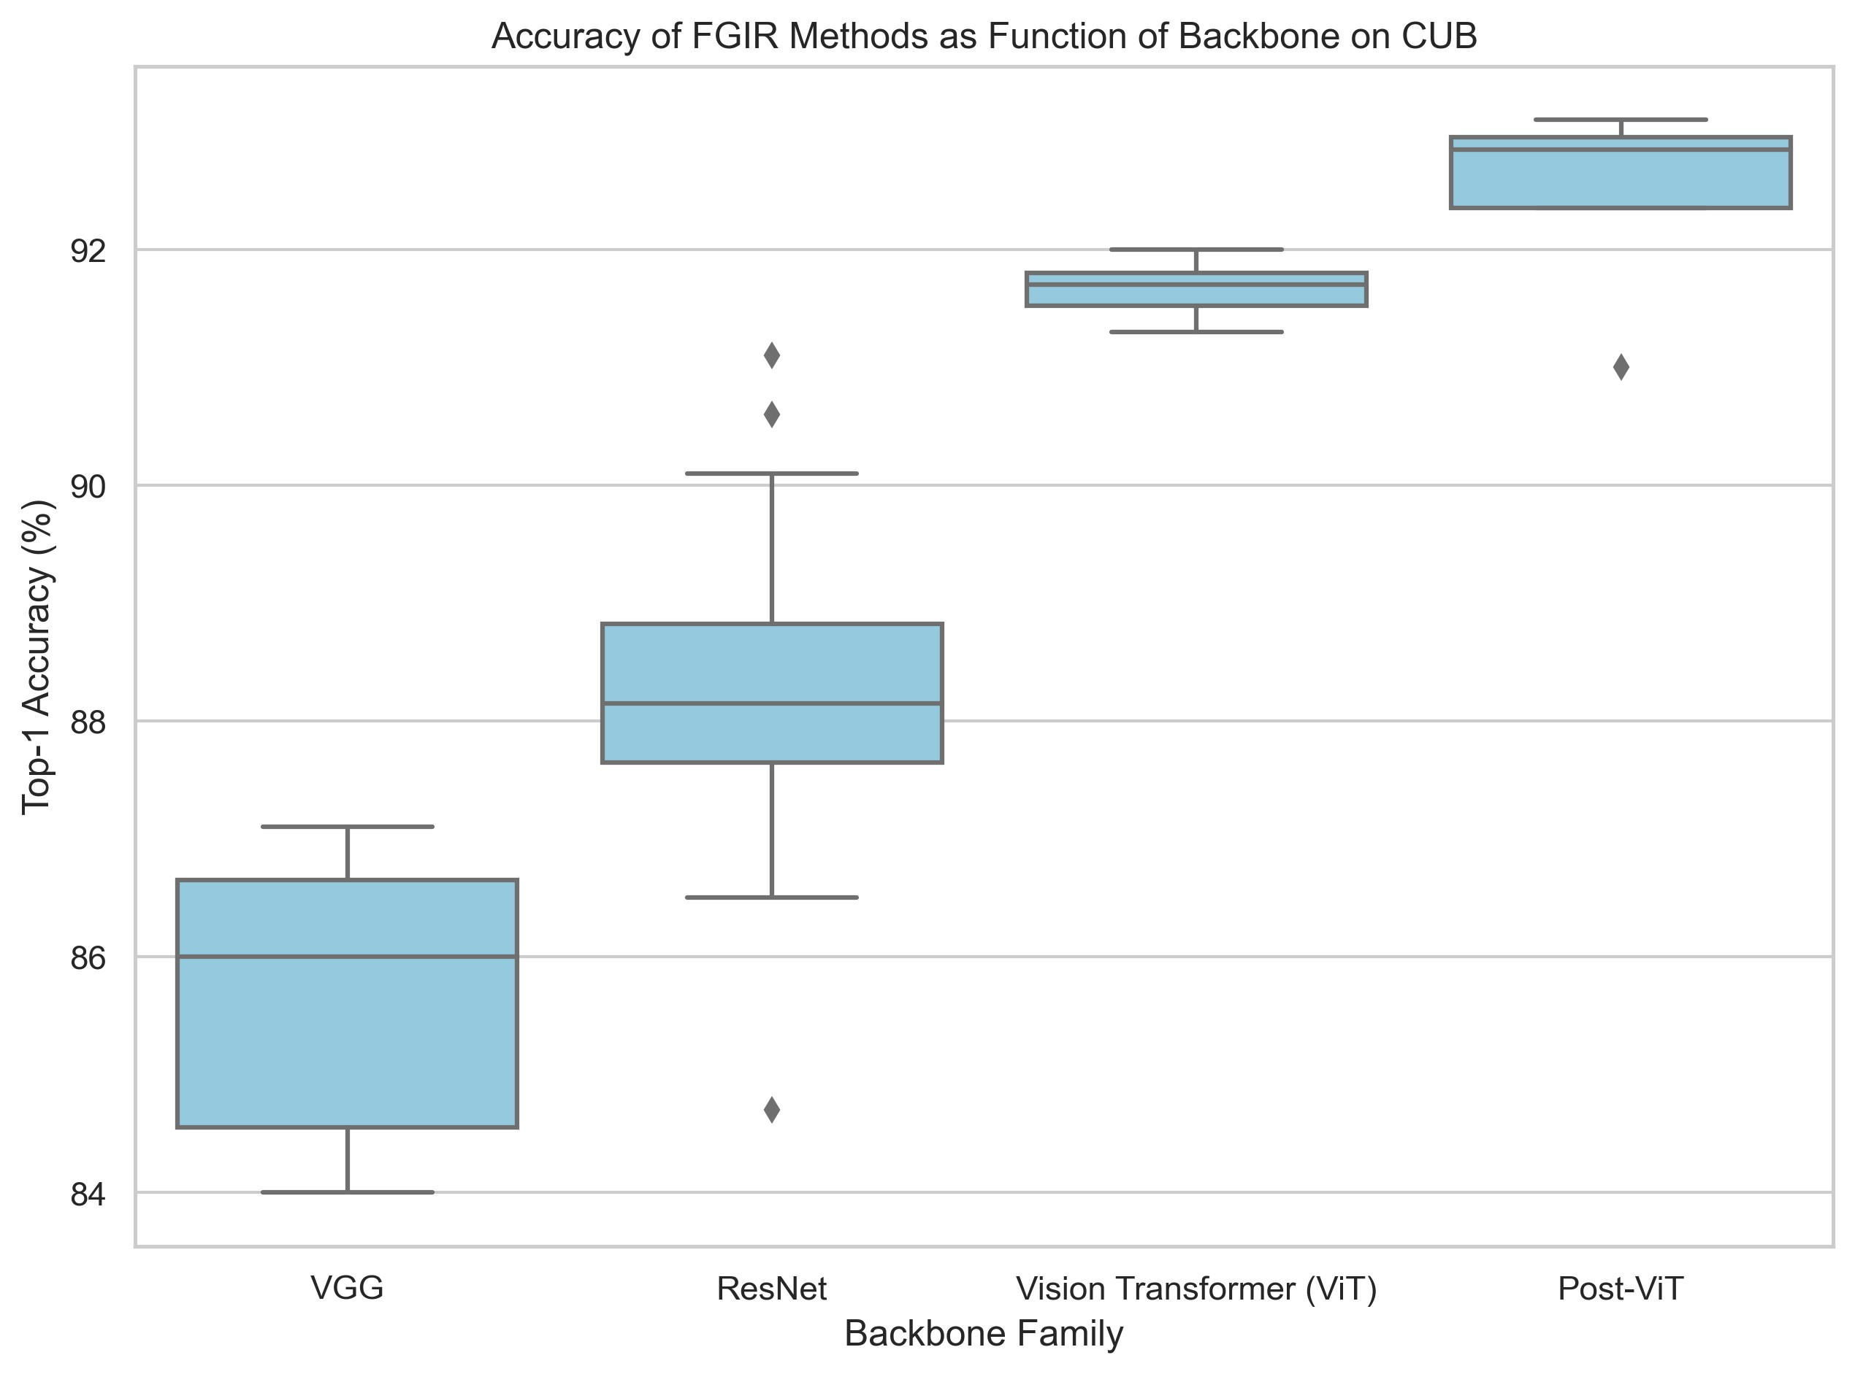
Backbone Importance in FGIR
FGIR performance (accuracy) is driven by backbone
Large improvement from transformer-based
How to Design Your Fine-Grained Image Recognition System. Rios et al. Work in progress.
Notes:
Backbone and data

Slide 31
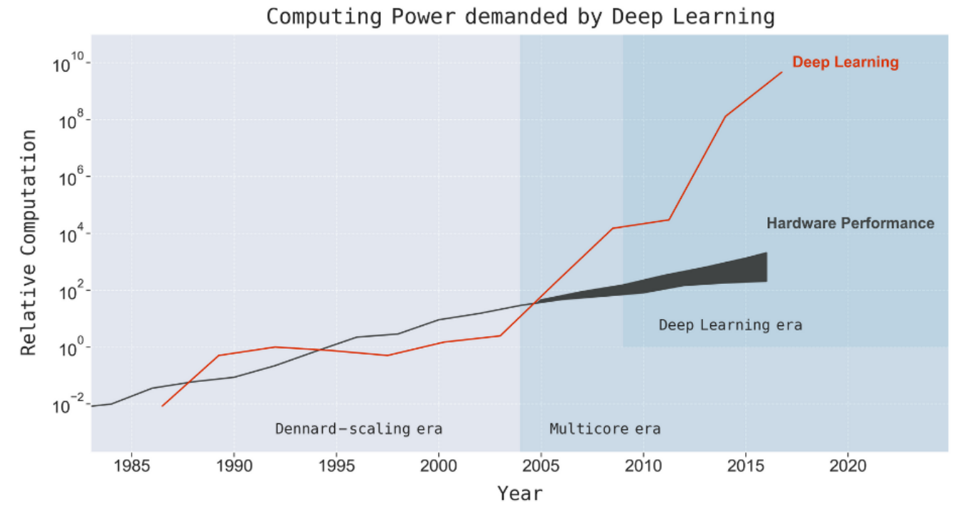
Trend of Larger Models
Accuracy is driven by backbone (size)
The Computational Limits of Deep Learning. Thompson et al. arXiv 20
Notes:
Define applicable when it comes to cost
Applicability
Two scenarios:
Low-power drone / autonomous vehicle for biodiversity equipped with (maybe solar power and battery) camera and neural processing unit. Must obtain an image, process it as fast as possible with limited resources to make autonomous decision (such as follow/track in case of an endangered species or a target for search).
Server batched inference (throughput): must receive hundreds or even thousands of images from multiple sources and process them as fast as possible to resend back to local instances for decisions
progressive improvements on benchmarks like image classification, text classification, etc. have been correlated with an increase in the network complexity, number of parameters, the amount of training resources required to train the network, prediction latency
GPT-3 comprises of 175 billion parameters, and costs millions of dollars to train just one iteration ([26]). This excludes the cost of experimentation / trying combinations of different hyper-parameters, which is also computationally expensive.
While these models perform well on the tasks they are trained on, they might not necessarily be efficient enough for direct deployment in the real world.
• Sustainable Server-Side Scaling: Training and deploying large deep learning models is costly. While training could be a one-time cost (or could be free if one is using a pre-trained model), deploying and letting inference run for over a long period of time could still turn out to be expensive in terms of consumption of server-side RAM, CPU, etc.. There is also a very real concern around the carbon footprint of datacenters even for organizations like Google, Facebook, Amazon, etc. which spend several billion dollars each per year in capital expenditure on their data-centers
Enabling On-Device Deployment: Certain deep learning applications need to run realtime on IoT and smart devices (where the model inference happens directly on the device), for a multitude of reasons (privacy, connectivity, responsiveness). Thus, it becomes imperative to optimize the models for the target devices.
Privacy & Data Sensitivity: Being able to use as little data as possible for training is critical when the user-data might be sensitive. Hence, efficiently training models with a fraction of the data means lesser data-collection required
New Applications: Certain new applications offer new constraints (around model quality or footprint) that existing off-the-shelf models might not be able to address. • Explosion of Models: While a singular model might work well, training and/or deploying multiple models on the same infrastructure (colocation) for different applications might end up exhausting the available resources.
The introduction of GPU-based (and later ASIC-based) deep learning led to widespread adoption of these systems. But the amount of computing power used in the largest cutting-edge systems grew even faster, at approximately 10× per year from 2012 to 2019 [35]. This rapid increase in computing burden far outpaced the ≈ 35× total improvement from moving to GPUs, the meager improvements from the last vestiges of Moore’s Law [19], or the improvements in neural network training efficiency [38]. Instead, much of the increase came from a much-less-economically-attractive source: running models for more time on more machines. For example, in 2012 AlexNet trained using 2 GPUs for 5-6 days[22], in 2017 ResNeXt-101 [39] was trained with 8 GPUs for over 10 days, and in 2020 Meta Pseudo Labels (EfficientNet-L2) was trained with 2048 TPU cores for 11 days[40]. Another extreme example is the machine translation system, “Evolved Transformer”, which used more than 2 million GPU hours and cost millions of dollars to run[41, 42].9 Scaling deep learning computation by scaling up hardware hours or number of chips is problematic in the longer-term because it implies that costs scale at roughly the same rate as increases in computing power [35], which (as we show) will quickly make it unsustainable
9 Some have argued that neural architecture search costs should not be included in training costs because they help reduce inference costs [43]. While we agree with the latter point, it doesn’t change that this search is part of the initial training cost and thus we include it in our calculations.

Slide 32
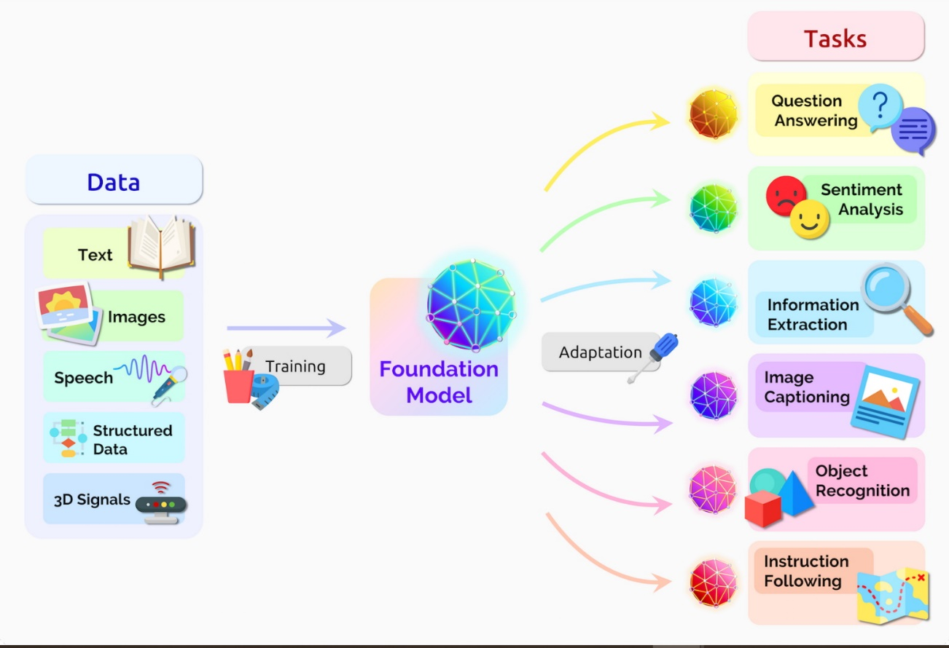
Foundation Models
In recent times there’s been a large number of pretrained (PT) foundation models (FM) released
FM: a large model that has been pretrained on a large datasets with a general objective and usually can perform well on a wide variety of tasks
https://blogs.nvidia.com/blog/what-are-foundation-models/

Slide 33
How to Take Advantage of These?
How to make models more efficient or use them more effectively?
Efficiency: software acceleration (SWA) such as pruning (model/input), quantization, distillation
Effectiveness: SWA & parameter-efficient transfer learning (PETL)

Slide 34
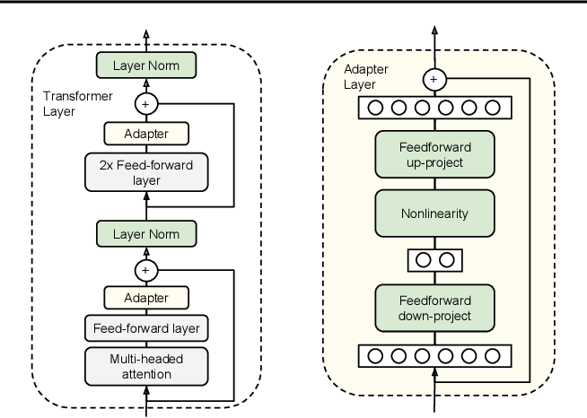
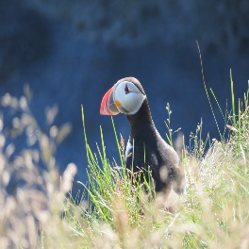
Parameter-Efficient Transfer Learning
Foundation models are very large and have many parameters
Adaptation such as fine-tuning (FT) may be necessary if we want to obtain the absolute best results so fine-tuning becomes an issue
However FT can be very costly specially if we need to FT multiple times
PETL is a family of methods that aim to improve the efficiency of transfer learning by reducing the number of parameters that we need to fine tune
Also known as parameter-efficient fine-tuning or delta-tuning
Frozen Feature Encoder ❄️
He a d🔥
Linear classifier evaluation
Parameter-Efficient Transfer Learning for NLP
Notes:
Reuse most parameters of a model
critical for cases where misclassification can result into losses of money or life
1x task we may end up with 10 B parameters for a FM with 10 billion parameters but if we have 100x tasks that we need to fine tune we may end up with 1 T parameters
Forward pass
And backward pass
transfer learning

Slide 35
FGIR Deployment Problems
What to do if need to deal with N tasks?
Train N FGIR models specialized on each task
Finetune backbone + FGIR modules for larger datasets can be costly and specially if under constrained resources (embedded / IoT devices)
Each model needs to be stored separately so N the number of parameters further constraining resources
Train N linear classifiers
Linear classifiers are light-weight and training can be done under constrained resources as number of FLOPs and VRAM usage is drastically reduced
There’s limited literature on linear classifier usage for fine-grained, mostly 3 or 4 datasets (Flowers, Pets, iNat)
Gap compared to fine-tuned can vary significantly
Train N FGIR modules for each task on top of a frozen backbone:
Combine advantages of fine-tuning N whole models and linear classifiers
Much lower cost compared to fine-tuning two whole models, higher than linear but should obtain much better performance as the FGIR modules and losses help the model focus on fine-grained differences

Slide 36
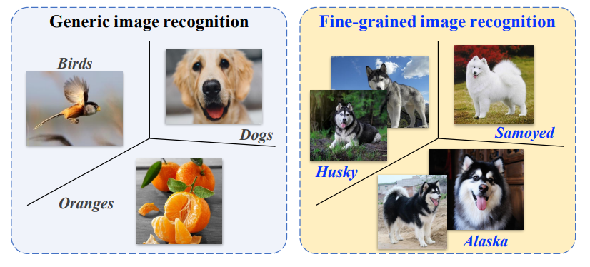
Challenge: Available Training Data
Few number of training images compared to coarse recognition
Hundreds (${10}^{2}$): Cotton and Soy
Thousands (${10}^{3}$): Aircraft, Cars, CUB, Flowers, Pets
Ten thousands (${10}^{4}$): Dogs, Food, Moe, NABirds, VegFru
Hundred thousands (${10}^{5}$): DAFB and iNat17
Million (${10}^{6}$): ImageNet-1k
Notes:
Difficulty of Labeling requires expert to label

Slide 37
Additional Motivation Behind PETL: Scaling

Slide 38
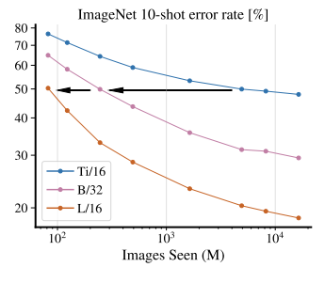
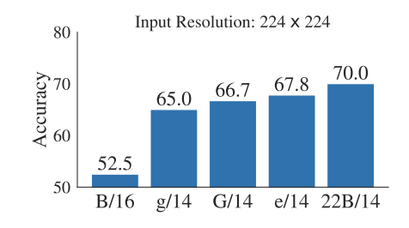
ViT Scaling
Predictable scaling according to dataset size, training strategy, training length, model size
Deploy a larger model with linear, FGIR module on top of frozen backbone instead of a fully fine-tuned smaller FGIR model? Accuracy vs cost
Scaling Vision Transformers. Zhai XH / Beyer L. Google. CVPR 22. 348.
FlexiViT: One Model for All Patch Sizes. Beyer L / Pavetic F. Google. arXiv 2022/12. 1.

Slide 39
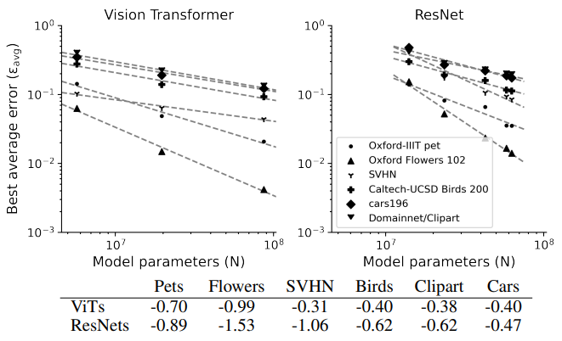
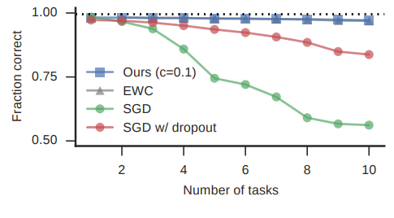
Catastrophic Forgetting
Forgetting old concepts as new ones are learned
Scaled up models pretrained on large datasets forget less
A continual learning survey: Defying forgetting in classification tasks. De Lange M / Tytelaars T. KU Leuven, BE. TPAMI 20. 667
Continual Learning Through Synaptic Intelligence. Zenke F / Ganguli. Stanford U, US. ICML 17. 1644.
Effect of Model and Pretraining Scale on Catastrophic Forgetting in Neural Networks. Ramasesh V / Dyer E. Google. ICLR 22. 28.

Slide 40
Related Work

Slide 41


Related Work on UFGIR
Employ generic recognition backbones and equip with modules to select discriminative features or loss to more effectively use fine-grained features
Most methods employ transformer-based backbones with large cost
Feature Fusion Vision Transformer for Fine-Grained Visual Categorization. Wang J / Gao YS. U of Warwick, UK / Griffith U, AU. BMVC 21. 28.
Learning Contrastive Self-Distillation for Ultra-Fine-Grained Visual Categorization Targeting Limited Samples. TCSVT 24

Slide 42
Method

Slide 43
Overview

Slide 44
Down-Sampling Inter-Layer Adapter

Slide 45
Self-Supervised Intermediate Training
Leaves dataset: combination of Cotton, SoyAgeing, SoyGene, SoyGlobal, SoyLocal
Parametric Instance Discrimination
Discriminative unsupervised feature learning with convolutional neural networks. Dosovitskiy A / Brox T. U of Freiburg, DE. NIPS 14.
Parametric Instance Classification for Unsupervised Visual Feature Learning. Cao Y / Han H. Microsoft / Tsinghua U, CN. NeurIPS 20.
Training Vision Transformers with Only 2040 Images. Cao YH / Wu JX. Nanjing U, CN. ECCV 22.

Slide 46


Intermediate Features Contrastive Loss
IFACD uses intermediate features from teacher as additional positives for contrastive loss
SelfCon uses intermediate features from network as additional positives for contrastive loss (similar to Self-Distillation)
Ours uses only intermediate features for contrastive loss
Lightweight (bottleneck MLP)
Augmentations from EADA are additional positives
Originally planned to include attention pooling but GAP seems to be better
IFACD: Intermediate Features Augmented Contrastive Distillation. ICLR CSS Workshop 22.
Self-Contrastive Learning: Single-Viewed Supervised Contrastive Framework Using Sub-network. Bae SM / Yun SY. KAIST. AAAI 23 (arXiv 21)
Notes:
Auxiliary loss to help earlier layers learn discriminative features to perform better pruning (happening at earlier layers)

Slide 47




Contrastive Loss, SupCon, SelfCon (IFACD)
Contrastive aims to pull in positive pairs closer and push negatives pairs far
Originally positives are two augs of same image
SupCon extends positives to same class
SelfCon (and our previous work IFACD) extend positives to intermediate features of a network
https://arxiv.org/abs/2004.11362
https://arxiv.org/abs/2106.15499

Slide 48



SelfCon Issues
Requires small or full subnetworks for intermediate features
ResNet50
23.71 M parameters -> SelfCon requires 1.78x parameters
4.33 GFLOPs -> SelfCon requires 1.29x higher FLOPs
Memory and time are harder to measure as depend on HW but as network is inserted in the middle we can assume it takes an extra half forward pass
Self-Contrastive Learning: Single-Viewed Supervised Contrastive Framework Using Sub-network. Bae SM / Yun SY. KAIST. AAAI 23 (arXiv 21)
Notes:
resnet50,23.712932,4.131796992,4.119980644,4.098457094
SelfCon uses same structure for subnetwork as main network in IN dataset
They use a smaller version or MLP for smaller datasets
They do not include the FLOPs for the default resnet
We reported the detailed computational cost for pretraining with ResNet-18 and ResNet-50 in Table 15 and Table 16, respectively. All numbers for the ImageNet-100 and ImageNet results are measured on 8 RTX A5000 GPUs, and in other benchmarks on 8 RTX 2080 Ti GPUs. The overall trend for each backbone network is similar. Although SelfCon has larger parameters due to the auxiliary networks, the actual training memory and time were lower than SupCon because of the single-viewed batch. In other words, SelfCon with B = 512 requires a comparable memory cost with SupCon with B = 256
blocks, (3) same structure which is same as the backbone’s non-sharing block structure. After we found the optimal structure, we fixed the structure of the sub-network and found which position was the best. For ResNet architectures, there are three positions to attach; after the 1 st , 2 nd, and 3 rd block. For VGG-16 with BN, there are four positions, and for WRN-16-8, there are two positions possible. Note that blocks are divided based on the Max-Pooling layer in VGG-16 with BN. Table 7 presents the ablation study results for ResNet-18 and ResNet-50, and Table 8 presents the results for WRN-16-8 and VGG-16 with BN. We observed a trend: in shallow networks (e.g., WRN-16-8) the same structure was better, while fc was better in deeper networks (e.g., VGG-16 with BN and ResNet). Besides, the performance was consistently good when the exit path is attached after the midpoint of the encoder (e.g., 2 nd block in ResNet or 3 rd block in VGG architecture). Obviously, there are many combinations of placing sub-networks, and Table 7 and Table 8 presented an interesting result that some performance was the best when sub-networks are attached to all blocks. It seems that increasing the number of positive and negative pairs by various views from multiple sub-networks improves the performance. It is consistent with the argument of CMC (Tian, Krishnan, and Isola 2019a) that the more views, the better the representation, but our SelfCon learning is much more efficient in terms of the computational cost and GPU memory usage. However, for the efficiency of the experiments and a better understanding of the framework, we stuck to a single sub-network in all experimental settings. We further experimented on the large-scale benchmarks, ImageNet-100 and ImageNet. In the ImageNet-100 experiment, we fixed the learning rate for SelfCon and SelfCon-M to 0.5, which was found to be optimal in the previous section. SelfCon showed the accuracy of 85.5%, 86.1%, and 85.7% in the order of fc, small, and same structures, respectively, and in the case of SelfCon-M, the results were 84.6%, 85.8%, and 85.8%, respectively. We found out that small sub-network showed the best performance in SelfCon as well as SelfCon-M. Therefore, we fixed the small sub-network with a learning rate of 0.5 for the SelfCon methods. For ImageNet dataset, we compared the results of small structure with those of same structure. The classification performance degraded by 0.3% when we used small structure. Therefore, we concluded that a deeper sub-network structure is preferred in the large-scale benchmark

Slide 49
Intermediate Features Augmented Contrastive Loss
IFACD: Intermediate Features Augmented Contrastive Distillation. ICLR CSS Workshop 22.
Self-Contrastive Learning: Single-Viewed Supervised Contrastive Framework Using Sub-network. Bae SM / Yun SY. KAIST. AAAI 23 (arXiv 21)

Slide 50
Early Attention Data-Aware Data Augmentation

Slide 51


Early Attention Data Augmentation
Data augmentation based on attention (CAL/WS-DAN inspired)
CAL/WS-DAN use their own module (additional parameters, cost)
Other FGIR ViTs also use attention but accumulate all layers (1-12)
Ours uses only early layers (either two layers: 3-4, for cheap rollout, or a random mix of the early layers: 1-2, 1-3, 1-4, 2-3, 2-4, 3-4)
77 kFLOPs vs 167 MFLOPs (2167 cheaper)
The second scheme sometimes leads to better results if by itself but not when combined with the other two proposals
Notes:
2167 is factor of L-1
1 layer is reduced by factor of S (1 token instead of 197 tokens)

Slide 52


Efficient Dual Attention
Reduce FLOPs by a factor of sequence length (197 for image size 224 with patch size 16) for two layers
Compared to original rollout with 12 layers it’s reduced by 2167 (L-1*S)
Reduced complexity by a factor of L*S
Notes:
2167 is factor of L-1
1 layer is reduced by factor of S (1 token instead of 197 tokens)
(n×p)(�×�) and (p×m
nm(2p−1
og = (197*197)*(2*197-1)
red = (1*197)*(2*197-1)
og / re
flops = s*s*(2*s-1)

Slide 53
Experiment Methodology

Slide 54

Experiment Methodology
5 UFGIR datasets (Cotton, SoyAgeing, SoyGene, SoyGlobal, SoyLoc)
Report top-1 accuracy mean of 3 random seeds

Slide 55
Experiment Methodology
Optimizer: AdamW
Weight decay: 0.05
Batch size: 32
Image sizes: 224, 448
Backbones: 9 in total (all ViT B-16 architecture)
ViT, DeiT, DeiT3 (IN1k & IN21k), MIIL, MoCov3, DINO, MAE, CLIP LAION
TR methods:
Baseline (no TR)
Static pruning: EViT, DynamicViT
Dynamic pruning: ATS
Soft merging: SiT, PatchMerger
Hard merging: DPCKNN, ToMe
Keep rates: 10, 25, 50, 70, 100%
Reduction at 4th, 7th, 10th layers
Notes:
Reduction at 4th, 7th, 10th, of ViT

Slide 56
Results

Slide 57
Results
Table: our method vs SotA in PETL, PEFGIR, and FGIR
Image size 224
Image size 448
Include parameters and FLOPs
Ablation on components
Ablation on DS Conv initialization importance (cite ControlNet's zero convolution)
Ablation with B-32 backbone or larger (L-16/L-32) or other pretraining strategies (DeiT 3, CLIP)

Slide 58
Conclusion

Slide 59


Conclusion
Plug-and-play modules (CLA & CLC) to improve performance of token reduction in UFGIR across a wide variety of settings

Slide 60
Appendix

Slide 61
Papers on UFGIR
Benchmark Platform for Ultra-Fine-Grained Visual Categorization Beyond Human Performance. Yu XQ / Xiong SW. Griffith U, AU / Wuhan U of T, CN. ICCV 21
MaskCOV: A random mask covariance network for ultra-fine-grained visual categorization. Yu XH / Xiong SW. Griffith U, AU / Wuhan U of T, CN. Pattern Recognition 21.
Feature Fusion Vision Transformer for Fine-Grained Visual Categorization. Wang J / Yu XH / Gao YS. U of Warwick, UK / Griffith U, AU. BMVC 21.
SPARE: Self-supervised part erasing for ultra-fine-grained visual categorization. Yu XH / Gao YS. Griffith U, AU / U of Adelaide, AU. Pattern Recognition 22.
SSFE-Net: Self-Supervised Feature Enhancement for Ultra-Fine-Grained Few-Shot Class Incremental Learning. WACV 23 (look at motivation / related only)
Mix-ViT: Mixing attentive vision transformer for ultra-fine-grainedvisual categorization. Yu XH / Gao YS. Griffith U, AU. Pattern Recognition 2023.
CLE-ViT: Contrastive Learning Encoded Transformer for Ultra-Fine-Grained Visual Categorization. IJCAI 23.
Learning Contrastive Self-Distillation for Ultra-Fine-Grained Visual Categorization Targeting Limited Samples. TCSVT 24

Slide 62
Intermediate Features in FGIR
Bilinear CNN Models for Fine-grained Visual Recognition. Lin TY / Maji S. U of Massachusetts, US. ICCV 15. 2001. Outer product of (two) CNN feature maps (bilinear vector) as input to classifier
Diversified Visual Attention Networks for Fine-Grained Object Classification. Zhao B / Yan SC. Southwest Jiaotong U, CN. arXiv 16/06 / TMM 17. 400. Multi-scale canvas for CNN extractor + LSTM to refine CNN predictions across time steps
Object-Part Attention Model for Fine-Grained Image Classification. Peng YX / Zhao JJ. Peking U, CN. arXiv 17/04 / TIP 18. 304. Propose automatic object localization via saliency extraction (CAM) for localizing objects, object-part spatial constraints and clustering of parts based on clustered intermediate CNN filters
Higher-Order Integration of Hierarchical Convolutional Activations for Fine-Grained Visual Categorization. Cai SJ / Zhang L. HK Polytechnic University, HK. ICCV 17. 141. Bilinear pooling for multiple layers using 1x1 Convs and concatenating intermediate outputs
Multi-Attention Multi-Class Constraint for Fine-grained Image Recognition. Sun M / Ding ER. Baidu, CN. ECCV 18. 333. Multi-excitation (squeeze-and-excitation) for feature maps + loss to pull features from same excitation closer and pushes features from different excitations away
Hierarchical Bilinear Pooling for Fine-Grained Visual Recognition. Yu CJ / You XG. Huazhong U of S&T, CN . ECCV 18. 259. Combine intermediate features by element-wise multiplications + concatenation of bilinearly pooled outputs
Cross-X Learning for Fine-Grained Visual Categorization. Luo W / Lim S. South China Agricultural University, CN / FB. ICCV 19. 165. Multiple excitations (OSME with loss to distinguish excitations) with intermediate features (FPN + KD loss between intermediate predictions)
Feature Fusion Vision Transformer for Fine-Grained Visual Categorization. Wang J / Gao YS. U of Warwick, UK / Griffith U, AU. BMVC 21. 45. ViT for FGIR, select intermediate tokens based on layer-wise attention
AP-CNN: Weakly Supervised Attention Pyramid Convolutional Neural Network for Fine-Grained Visual Classification. Ding YF / Ma ZY / Ling HB. Beijing U of Posts & Telecomms, CN. TIP 21. 92. FPN with top-down & bottom-up paths + merged ROI cropping + ROI masking
Stochastic Partial Swap: Enhanced Model Generalization and Interpretability for Fine-grained Recognition. Huang SL / Tao DC. The University of Sydney, AU. ICCV 21. 22. Intermediate classifiers + changing features of one image with another randomly to inject noise
Multi-branch and Multi-scale Attention Learning for Fine-Grained Visual Categorization. Zhang F / Liu YZ. China U of Mining and T, CN. MMM 21. 79. Features maps of multiple layers (instead of one) to guide cropping
A Novel Plug-in Module for Fine-Grained Visual Classification. Chou PY / Kao WC. National Taiwan Normal U, TW. arXiv 22/02. 12. Intermediate classifier distribution sharpness as metric to select intermediate features + GCN to combine
Fine-Grained Object Classification via Self-Supervised Pose Alignment. Yang XH / Tian YH. Peng Cheng Lab, CN. CVPR 22. 5. Intermediate features classifiers with different label smoothing levels and graph matching to align parts for contrastive learning
Cross-layer Attention Network for Fine-grained Visual Categorization. Huang RR / Yang HZ. Tsinghua U, CN. arXiv 22/10 / CVPR 22 FGVC8 Workshop. 1. Refine intermediate features with top-level and top-level with intermediate features
Semantic Feature Integration network for Fine-grained Visual Classification. Wang H / Luo HC. Jiangnan U, CN. arXiv 23/02. 0. Intermediate predictions classifiers + loss (similar to SAC arXiv 22 and PIM arXiv 22) + sequence of modules to refine most discriminative intermediate features

Slide 63
Papers on PETL
Parameter-Efficient Transfer Learning for NLP. Houlsby N / Gelly S. Google. ICML 19. 1092.
Visual Prompt Tuning. Jia ML /Lim SN. Cornell U / Meta, US. ECCV 22. 151.
Convolutional Bypasses Are Better Vision Transformer Adapters. Jie SB / Deng ZH. Peking U, CN. Arxiv 22/07.
Head2Toe: Utilizing Intermediate Representations for Better Transfer Learning. Evci U / Mozer M. Google. ICML 22 (similar to ours, intermediate features)
Visual Query Tuning: Towards Effective Usage of Intermediate Representations for Parameter and Memory Efficient Transfer Learning. Tu CH / Chao WL. CVPR 23 (similar to ours, intermediate features)
Fine-grained Retrieval Prompt Tuning. Wang SJ / Wang ZH / Li HJ / Tian Q. Dalian U of T, CN. arXiv 22/07 / AAAI 23 (most similar to ours, parameter-efficient FGIR, but for retrieval)

Slide 64

Issues with VQT (and H2T)
Number of parameters: $\left(\left[D×N_{Q}×L\right]+D\right)×C$ -> ([768x5x12]+768)x200=
Average number of classes (median number of classes) in VTAB (VQT proposed and evaluated in this setting) < 50
Highest number of classes is Sun397 with 397
90M parameters for largest classification head
Average number of classes in our case > 100 and highest is 1938
1.48M parameterse for largest classification head and adapter parameters < 1M in all cases

Slide 65
Trainable Feature Encoder 🔥
He a d🔥
Traditional coarse recognition
Frozen Feature Encoder ❄️
He a d🔥
Linear classifier evaluation
Trainable Feature Encoder 🔥
Trainable Module🔥
He a d🔥
Traditional FGIR
Frozen Feature Encoder ❄️
Trainable Module🔥
He a d🔥
Parameter-Efficient FGIR
Legend:
Trainable 🔥
Frozen ❄️
Notes:
https://www.flickr.com/photos/anjalorenz/50145521371/in/photolist-2jpbUsF-2m7MQWY-2m6cnjQ-2gPQAUV-rH3Trj-2gPPP9a-2gPQByF-2gPQChz-2n9jahs-2n9e6mC-2nHhmPF-2mwA4Ty-2j2kn4i-2mnYed4-2nhMcGy-2gPPPHM-2gBVk5p-LHoK5o-2mV4x6f-X3cQpT-S725Km-2p1Xut7-2nvapro-2nvcTax-2mbfoAj-2nhNnrd-263SDSN-2oBNxfH-2mb6rXj-2nFmqVS-2nujLBc-2nEyT2i-2nEtPae-2oMH6WE-2fkwRqV-2oDAno7-2oDCfve-2oBbofn-2mbdYr8-JZ7iDv-2gjkYnN-2gkPSE1-2mbdYrJ-2gdneS7-2mbbhnP-2oLsznh-vtdCz9-wnVewd-2nEyQ5G-dT12zz

Slide 66
Trainable Feature Encoder 🔥
He a d🔥
Legend:
Traditional coarse recognition
Trainable 🔥
Frozen ❄️
Frozen Feature Encoder ❄️
He a d🔥
Linear classifier evaluation
Trainable Feature Encoder 🔥
Trainable Module🔥
He a d🔥
Traditional FGIR
Frozen Feature Encoder ❄️
Trainable Module🔥
He a d🔥
Parameter-Efficient FGIR
Notes:
https://www.flickr.com/photos/anjalorenz/50145521371/in/photolist-2jpbUsF-2m7MQWY-2m6cnjQ-2gPQAUV-rH3Trj-2gPPP9a-2gPQByF-2gPQChz-2n9jahs-2n9e6mC-2nHhmPF-2mwA4Ty-2j2kn4i-2mnYed4-2nhMcGy-2gPPPHM-2gBVk5p-LHoK5o-2mV4x6f-X3cQpT-S725Km-2p1Xut7-2nvapro-2nvcTax-2mbfoAj-2nhNnrd-263SDSN-2oBNxfH-2mb6rXj-2nFmqVS-2nujLBc-2nEyT2i-2nEtPae-2oMH6WE-2fkwRqV-2oDAno7-2oDCfve-2oBbofn-2mbdYr8-JZ7iDv-2gjkYnN-2gkPSE1-2mbdYrJ-2gdneS7-2mbbhnP-2oLsznh-vtdCz9-wnVewd-2nEyQ5G-dT12zz

Slide 67







Vision Transformer with ILA
Intermediate Layer Adapter
$$Z_{L}$$
SDS
Channel Downsampling
Embedding
CLS
2D Depthwise Convolution (DWC)
Residual Spatial Downsampling (RSDS): 2D DWC with Near One Initialization)
Transformer Encoder Group
BatchNorm
Intermediate Layer Adapter (ILA)
Nonlinear Activation
Transformer Encoder Group
Pointwise Convolution
Intermediate Layer Adapter (ILA)
Channel Upsampling
Transformer Encoder Group
Classification Head
+
Predictions
Legend:
Trainable 🔥
Frozen ❄️
$${\hat{Z}}_{L}$$

Slide 68




Vision Transformer with ILA
Intermediate Layer Adapter
$$Z_{L}$$
SDS
Channel Downsampling
Embedding
CLS
CLS
Transformer Encoder Group
2D Depthwise Convolution (DWC)
Residual Spatial Downsampling (RSDS): 2D DWC with Near One Initialization
Intermediate Layer Adapter (ILA)
CLS
CLS
BatchNorm
Transformer Encoder Group
Nonlinear Activation
Intermediate Layer Adapter (ILA)
Pointwise Convolution
CLS
Channel Upsampling
Transformer Encoder Group
Classification Head
+
Predictions
$${\hat{Z}}_{L}$$
Legend:
Trainable 🔥
Frozen ❄️

Slide 69
Vision Transformer with ILA
Intermediate Layer Adapter
$$Z_{L}$$
Channel Downsampling
Embedding
CLS
CLS
Transformer Encoder Group
2D Depthwise Convolution (DWC)
Residual Spatial Downsampling (2D DWC with Near One Initialization)
Intermediate Layer Adapter (ILA)
CLS
CLS
BatchNorm
Transformer Encoder Group
Nonlinear Activation
Intermediate Layer Adapter (ILA)
Pointwise Convolution
CLS
Channel Upsampling
Transformer Encoder Group
Classification Head
+
Predictions
$${\hat{Z}}_{L}$$
Legend:
Trainable 🔥
Frozen ❄️

Slide 70
Future Work: SSL for PETL
PPEA-Depth: Progressive Parameter-Efficient Adaptation for Self-Supervised Monocular Depth Estimation. AAAI 24
Parameter Efficient Self-Supervised Geospatial Domain Adaptation. Scheibenreif L / Borth D. U of St Gallen, CH. CVPR 24
Parameter Efficient Fine-tuning of Self-supervised ViTs without Catastrophic Forgetting. CVPR 24 Workshop (eLVM).
Self-supervised adapter trained on wide variety of FGIR tasks
In the end only train head or use some prompt method (or k-NN) to do zero-shot classification
https://github.com/YuejiangDong/PPEA-Depth
https://github.com/hsg-aiml/gda
https://github.com/rezaakb/peft-vit

